Slide 1
Modern DataMining
INS4017
L0. Deep Learning in Python

Slide 2
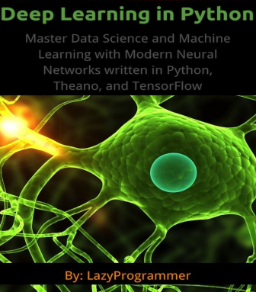
Introduction
Deep Learning in Python Master Data Science and Machine Learning with Modern Neural Networks written in Python, Theano, and TensorFlow
use the Python programming language, along with the numerical computing library Numpy.
how to build a deep network using Theano and TensorFlow, which are libraries built specifically for deep learning and can acceleratecomputation by taking advantage of the GPU

Slide 3
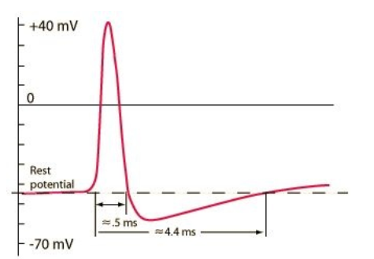
1. a neural network?
Signals are passed from one neuron to another via what is called an “action potential”.
It is a spike in electricity along the cell membrane of a neuron.
The interesting thing about action potentials is that either they happen, or they don’t.
There is no “in between”.
This is called the “all or nothing” principle.
Below is a plot of the action potential vs. time, with real, physical units.

Slide 4
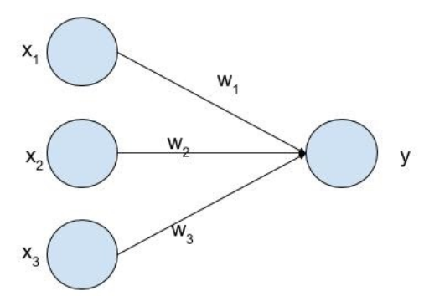
net
Neurons with strong connections will be turned “on” by each other.
So if one neuron sends a signal (action potential) to another neuron, and their connection is strong, then the next neuron will also have an action potential, would could then be passed on to other neurons,
Specifically, neurons are the perfect model for a yes / no, true / false, 0 / 1 type of problem.
We call this “binary classification” and the machine learning analogy would be the “logistic regression” algorithm.

Slide 5
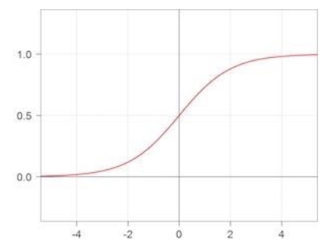
…
Because we’re going to have to eventually deal with actual numbers and formulas, let’s y=sigmoid(w1*x1+w2*x2+w3*x3)
we will ignore the bias term, since it can easily be included in the given formula by adding an extradimension x0.
So each input neuron gets multiplied by its corresponding weight (synaptic strength) and added to all the others.
We then apply a “sigmoid” function on top of that to get the output y. The sigmoid is defined as: sigmoid(x)=1/(1+exp(-x))

Slide 6
2. Getting output from a neural network
Get some data to work with
Assuming you don’t yet have any data to work with, you’ll need some to do the examples in this book. https://kaggle.com is a great resource for this.
I would recommend the MNIST dataset. MNIST is a subset of a larger set available from NIST. The MNIST database of handwritten digits has a training set of 60,000 examples, and a test set of 10,000 examples.
If you want to do binary classification you’ll have to choose another dataset.
NIST National Institute of Standards and Technology

Slide 7
Data set
The data you’ll use for any machine learning problem often has the same format.
We have some inputs X and some labels or targets Y.
Each sample (pair of x and y) is represented as a vector of real numbers for x and a categorical variable (often just 0, 1, 2, …) for y.
You put all the sample inputs together to form a matrix X.
Each input vector is a row. So that means each column is a different input feature.
Thus X is an N x D matrix, where N = number of samples and D = the dimensionality of each input.
If y is not a binary variable (0 or 1), you can turn it into a matrix of indicator variables, which will be needed later when we are doing softmax
So for the MNIST example you would transform Y into an indicator matrix (a matrix of 0s and 1s) where Y_indicator is an N x K matrix, where again N = number of samples and K = number of classes in the output. For MNIST of course K = 10.

Slide 8
net
Architecture of an artificial neural network
Unlike biological neural networks, where any one neuron can be connected to any other neuron, artificial neural networks have a very specific structure.
In particular, they are composed of layers.
Each layer feeds into the next layer.
There are no “feedback” connections.

Slide 9
…
Feedforward action
Let us complete the formula for y. First, we have to compute z1 and z2. z1 = sigmoid(w11*x1 + w12*x2) z2 = sigmoid(w21*x1 + w22*x2)
And then y can be computed as: y = sigmoid(v1*x1 + v2*x2)
Note that inside the sigmoid functions we simply have the “dot product” between the input and weights.

Slide 10
…
Binary classification
As you can see, the last layer of our simple network is just a logistic regression layer.
We can interpret the output as the probability that Y=1 given X.
Of course, since binary classification can only output a 0 or 1, then the probability that Y=0 given X: P(Y=0 | X) = 1 - P(Y=1 | X), because they must sum to 1
Softmax
What if we want to classify more than 2 things? For example, the famous MNIST dataset contains the digits 0-9, so we have 10 output classes.
In this scenario, we use the softmax function, which is defined as follows: softmax(a[k]) = exp(a[k]) / { exp(a[1]) + exp(a[2]) + … + exp(a[k]) + … + exp(a[K]) }

Slide 11
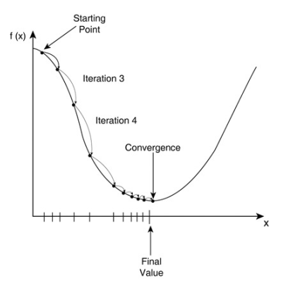
3. Training a neural network with backpropagation
There is no way for us to “solve for W and V” in closed form. Recall from calculus that the typical way to do this is to find the derivative and set it to 0.
We have to instead “optimize” our objective function using a method called gradient descent
Convince yourself that by going along the direction of the gradient, we will always end up at a “lower” J than where we started.

Slide 12
4. Bias in Machine Learning Algorithms
Bias in ML is an sort of mistake in which some aspects of a dataset are given more weight and/or representation than others.
Types of Machine Learning Bias:
Exclusion – this one is most frequent during the preprocessing stage of data analysis. Most of the time, it’s an instance of deleting important data that’s been deemed unimportant. It can also happen as a result of the systematic omission of certain data.
Recall – This is a type of assessment bias that occurs frequently during the phase of a project known as data labeling. When you name types of data that are similar, in different ways, you get recall bias.
Sample – Sample bias occurs when the realities of the environment in which an ML model will run do not reflect the dataset.
Association – Association bias happens when a cultural bias is reinforced or multiplied by an ML model.

Slide 13
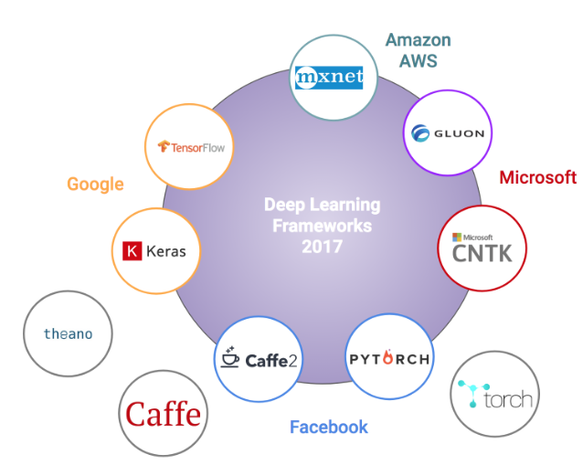
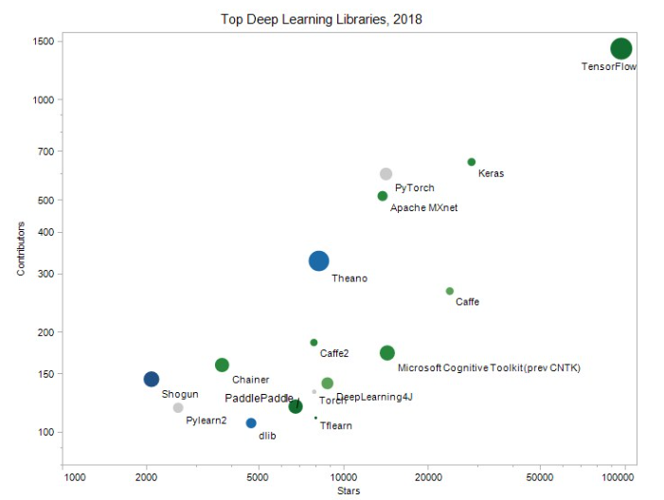
5. Theano

Slide 14
…
Theano is a Python library that is very popular for deep learning. It allows you to take advantage of the GPU for faster floating point calculations, since, as you may have seen, gradient descent can take quite awhile.
Moving from Numpy to Theano is a whole other beast.
There are a lot of new concepts that just do not look like regular Python.
So let’s first talk about Theano variables.
Theano has different types of variable objects based on the number of dimensions of the object.
For example, a 0-dimensional object is a scalar, a 1-dimensional object is a vector, a 2-dimensional object is a matrix, and a 3+ dimensional object is a tensor.
They are all within the theano.tensor module.
So in your import section: import theano.tensor as T

Slide 15
6. TensorFlow
TensorFlow is a newer library than Theano developed by Google. It does a lot of nicethings for us like Theano does, like calculating gradients.
Once you have TensorFlow installed, we’ll do a simple matrix multiplication example like we did with Theano.
Import as usual: import tensorflow as tf

Slide 16
8. Unsupervised learning, autoencoders, restricted Boltzmann machines, convolutional neural networks, and LSTMs
there are other “optimization” functions that neural networks can train on, that don’t even need a label at all!
This is called “unsupervised learning”, and algorithms like kmeans clustering, Gaussian mixture models, and principal components analysis fall into this family.
Neural networks have 2 popular ways of doing unsupervised learning: (i) Autoencoders; (ii) Restricted Boltzmann Machines.
Surprisingly, when you “pre-train” a neural network using either of these unsupervised methods, it helps you achieve a better final accuracy!

Slide 17

Thank for
Your attention

